Slide 1

CMPT 413/713: Natural Language Processing
Pretraining Language Models
Zhiyun (Richard) Peng
2026-11-4
Adapted from slides from Angel Chang, Anoop Sarkar, Danqi Chen, Karthik Narasimhan, and Justin Johnson, Chris Manning, Abigail See, Andrej Karpathy, Graham Neubig
Notes:
http://demo.clab.cs.cmu.edu/NLP/

Slide 2


Pretraining and fine-tuning
Pretraining
Big pile of unlabeled text data!
Lots of resources to train!
Supervised fine-tuning
Annotated data specific (usually small)
Initialize with pre-trained model
Helps to build
Useful representations of language
Provide good initial parameters for downstream tasks
Probability distributions that can be sampled from
Useful for
Task / domain specific fine-tuning
Instruction fine-tuning

Slide 3
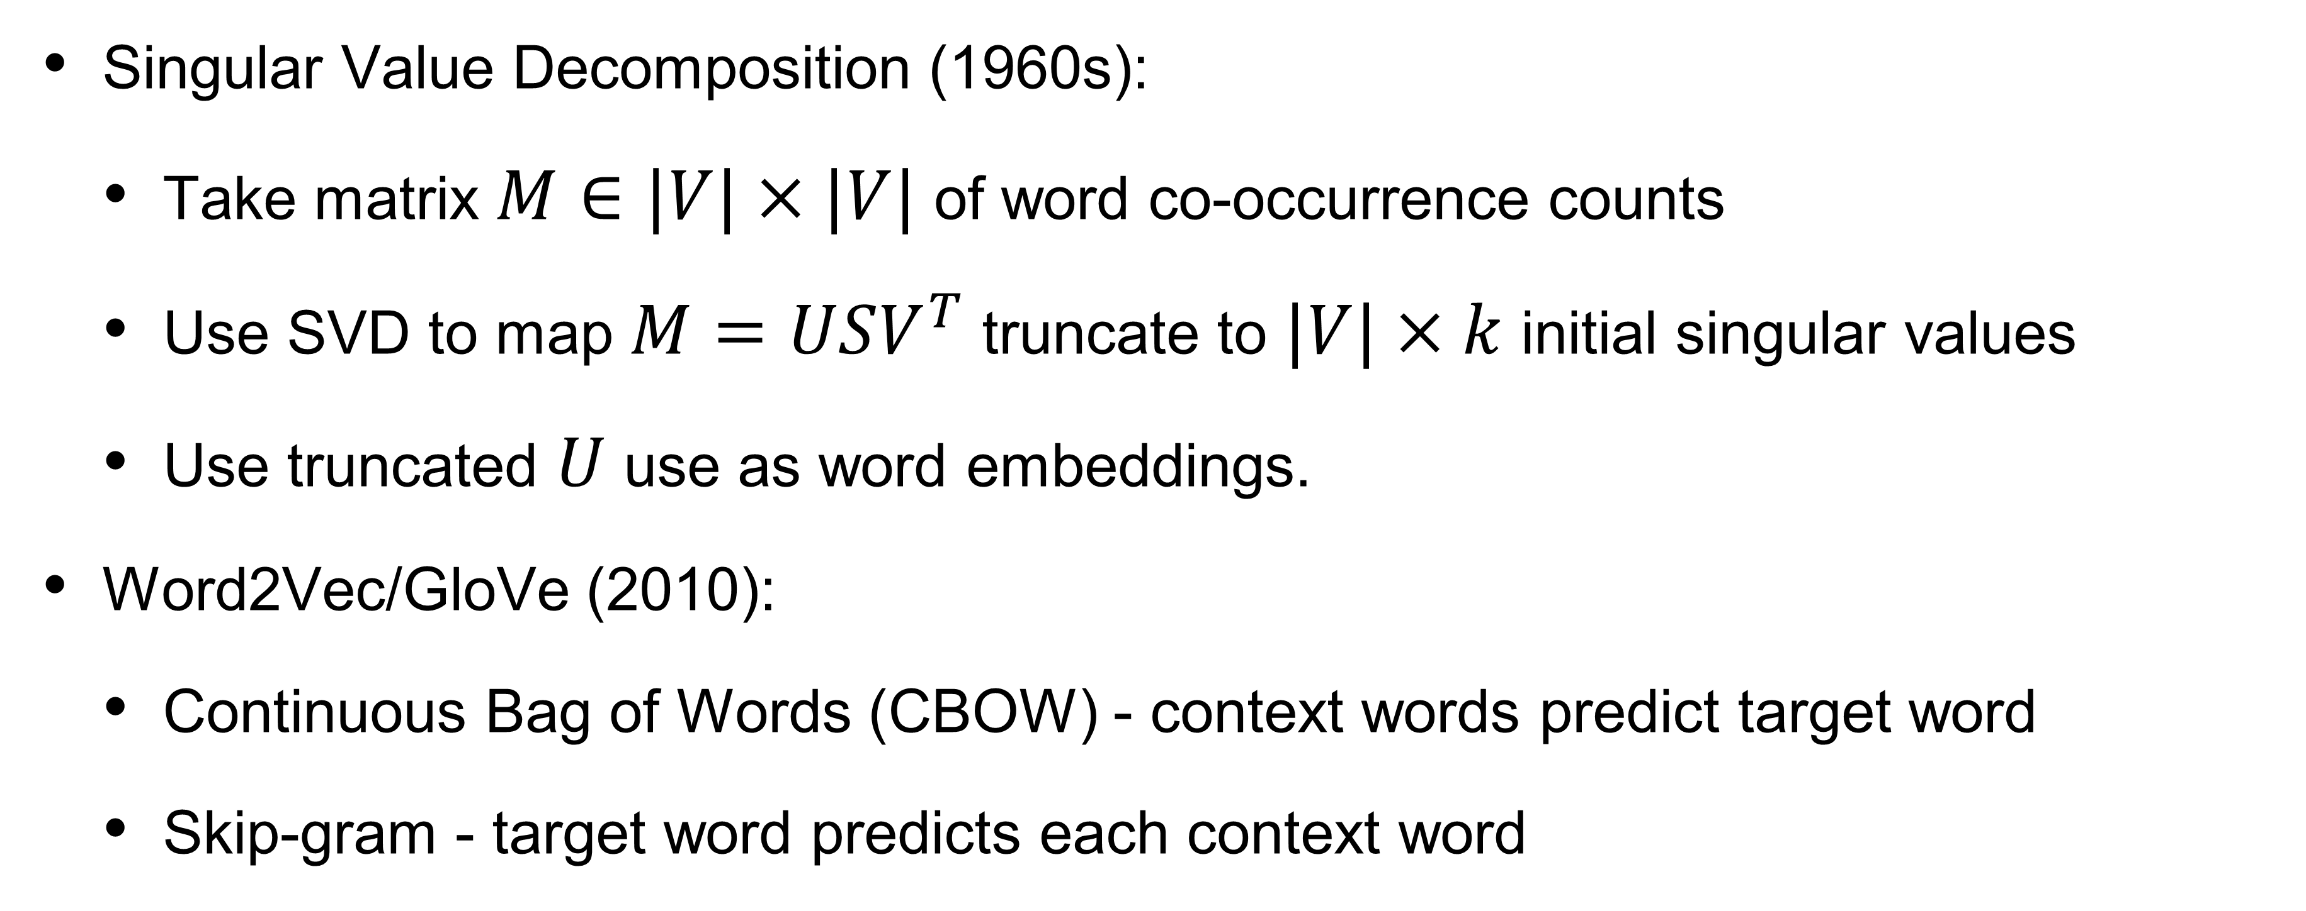
Brief History of Pre-training
1960 to 2015
Singular Value Decomposition (1960s):
  Take matrix $M∈|V|×|V|$ of word co-occurrence counts
  Use SVD to map $M=USV^{T}$ truncate to $|V|×k$ initial singular values
  Use truncated $U$ use as word embeddings.
Word2Vec/GloVe (2010):
  Continuous Bag of Words (CBOW) - context words predict target word
  Skip-gram - target word predicts each context word

Slide 4
Brief History of Pre-training
2015 to now
Pretrain and fine-tune LSTM models (2015-2017)
Pretrain and fine-tune deep transformer models (2018-2022)
  GPT1, GPT2, BERT, RoBERTa, …
Pretrain and use LLM with in-context learning (2022 - 2023)
Pretrain + post-training (2023 - present)
  GPT 3.5: Instruction tuning, preference optimization
  Modern LLM: multi-stages of pretraining / post-training with synthetic (generated) data for reasoning, long-context; multi-modal training

Slide 5
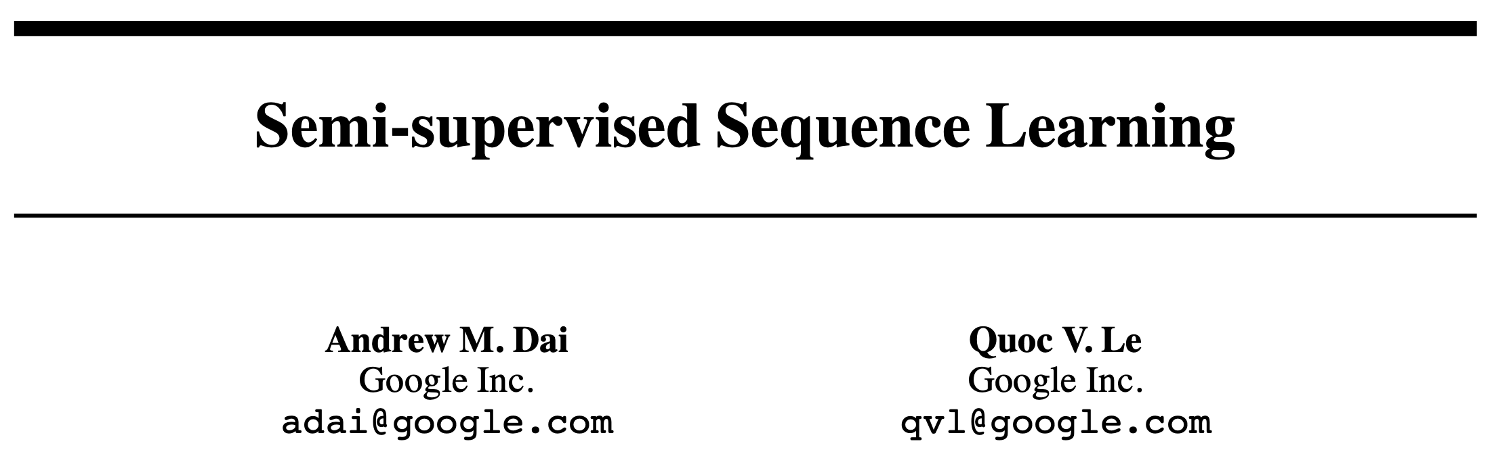
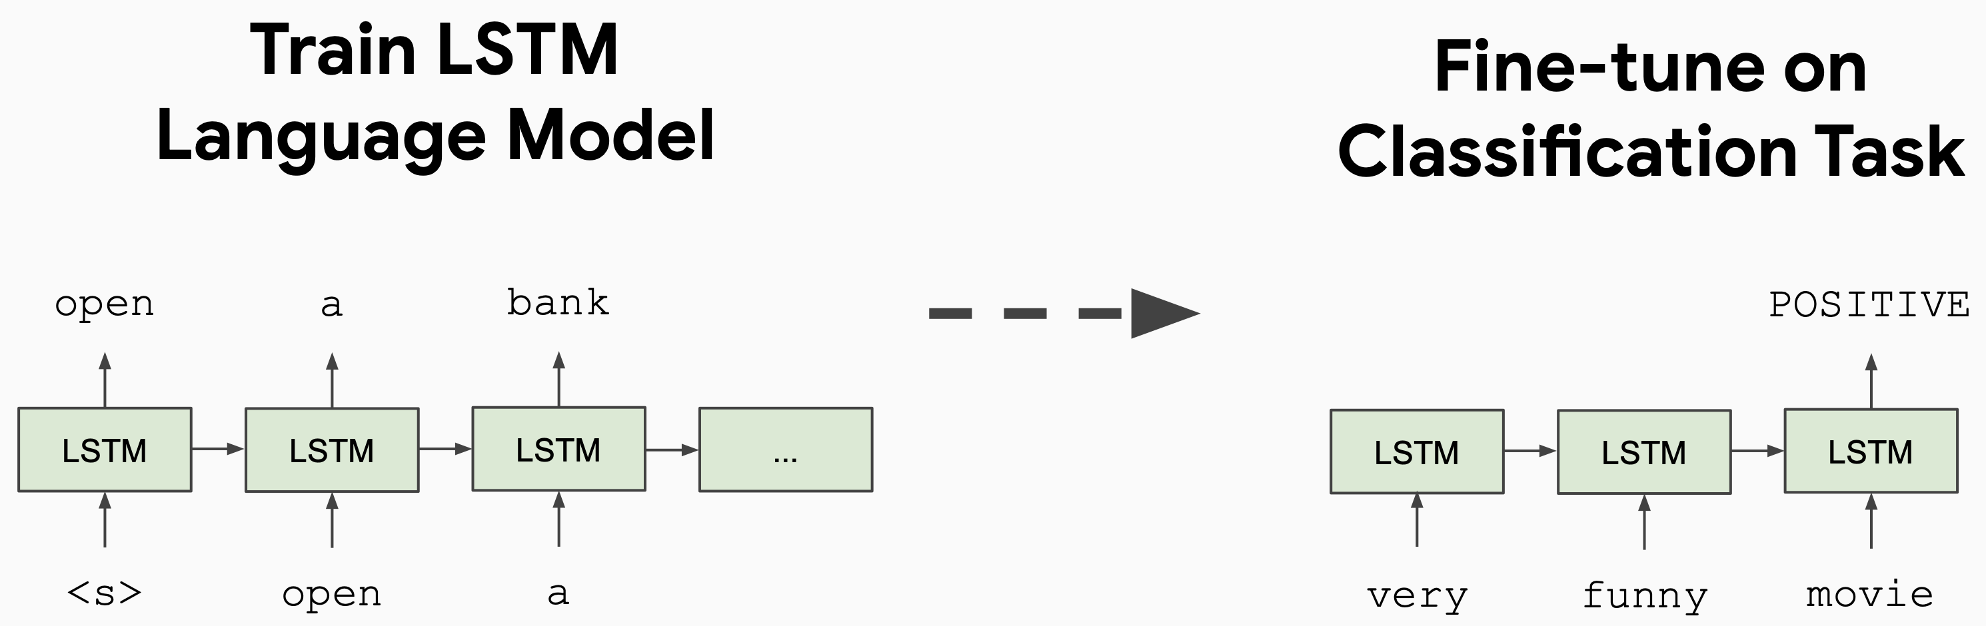
Fig from J. Devlin BERT slides
https://arxiv.org/abs/1511.01432
Nov 2015

Slide 6
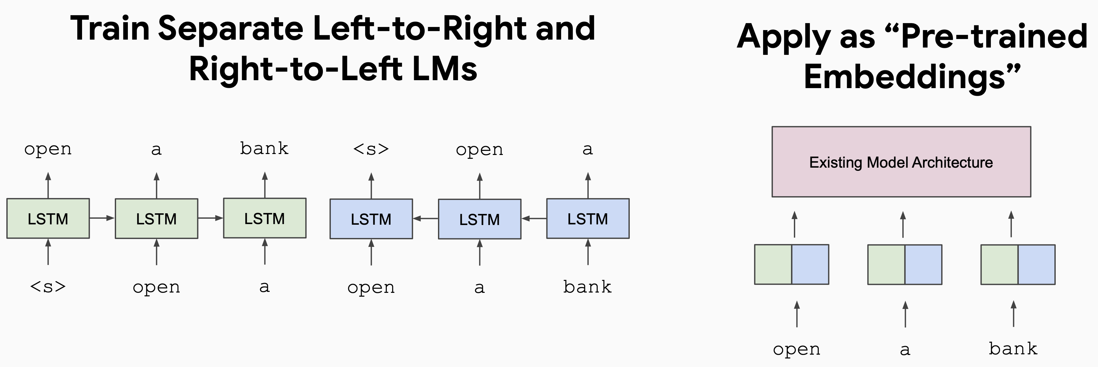
ELMO
Fig from J. Devlin BERT slides
https://arxiv.org/abs/1802.05365

Slide 7
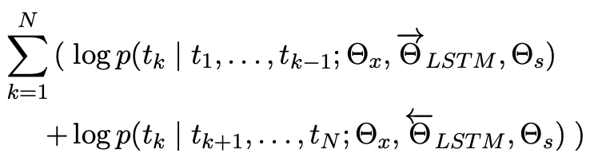
ELMo (Embeddings from Language Models)
# tokens in the sentence
LSTM parameters
Pretrain LM
input embeddings
softmax layer
Tied (same) for the two directions
Backward LM
Forward LM
Let’s stick to
in this skit
(figure credit: Jay Alammar
http://jalammar.github.io/illustrated-bert/)

Slide 8
ELMo
After training LM
To get the ELMO embedding of a word (“stick”):
Concatenate forward and backward embeddings and take weighted sum of layers
(figure credit: Jay Alammar
http://jalammar.github.io/illustrated-bert/)

Slide 9
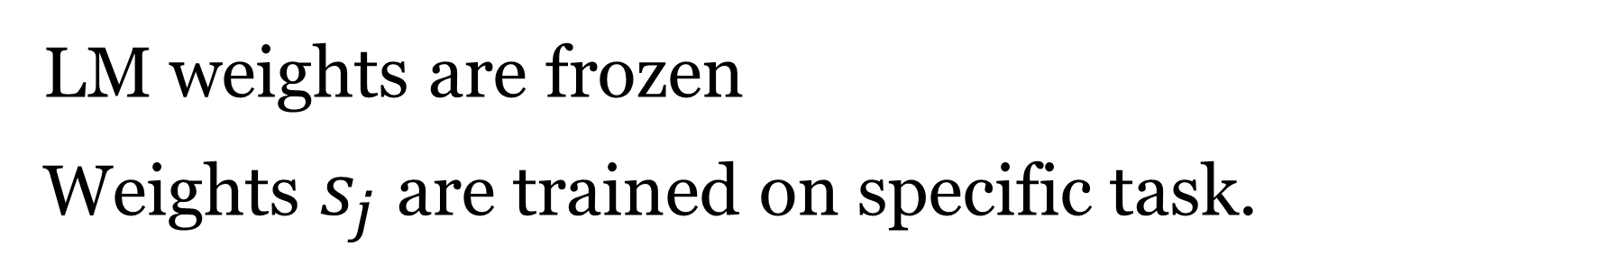
ELMo
LM weights are frozen
Weights $s_{j}$ are trained on specific task.
To get the ELMO embedding of a word (“stick”):
Concatenate forward and backward embeddings and take weighted sum of layers
(figure credit: Jay Alammar
http://jalammar.github.io/illustrated-bert/)

Slide 10
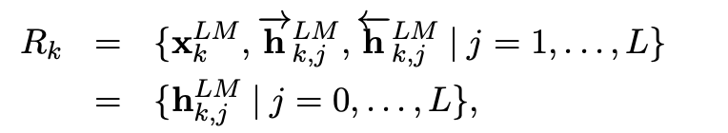
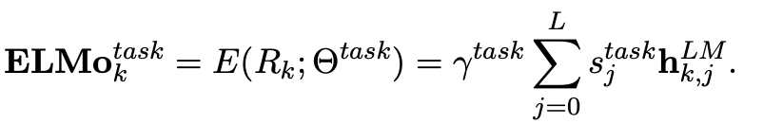

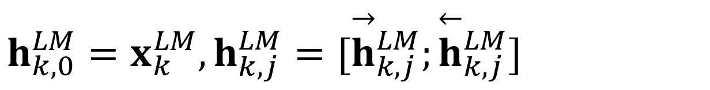
Summary: How to get ELMo embedding?
Input embeddings
Hidden state
L is # of layers
Token representation
$$h_{k,0}^{LM}=x_{k}^{LM},h_{k,j}^{LM}=[{\overset{→}{h}}_{k,j}^{LM};{\overset{←}{h}}_{k,j}^{LM}]$$
hidden states
Task specific learnable parameters
$γ^{task}$: allows the task model to scale the entire ELMo vector
$s_{j}^{task}$: softmax-normalized weights across layers
To use: plug ELMo into any (neural) NLP model: freeze all the LMs weights and change the input representation to:
(could also insert into higher layers)

Slide 11
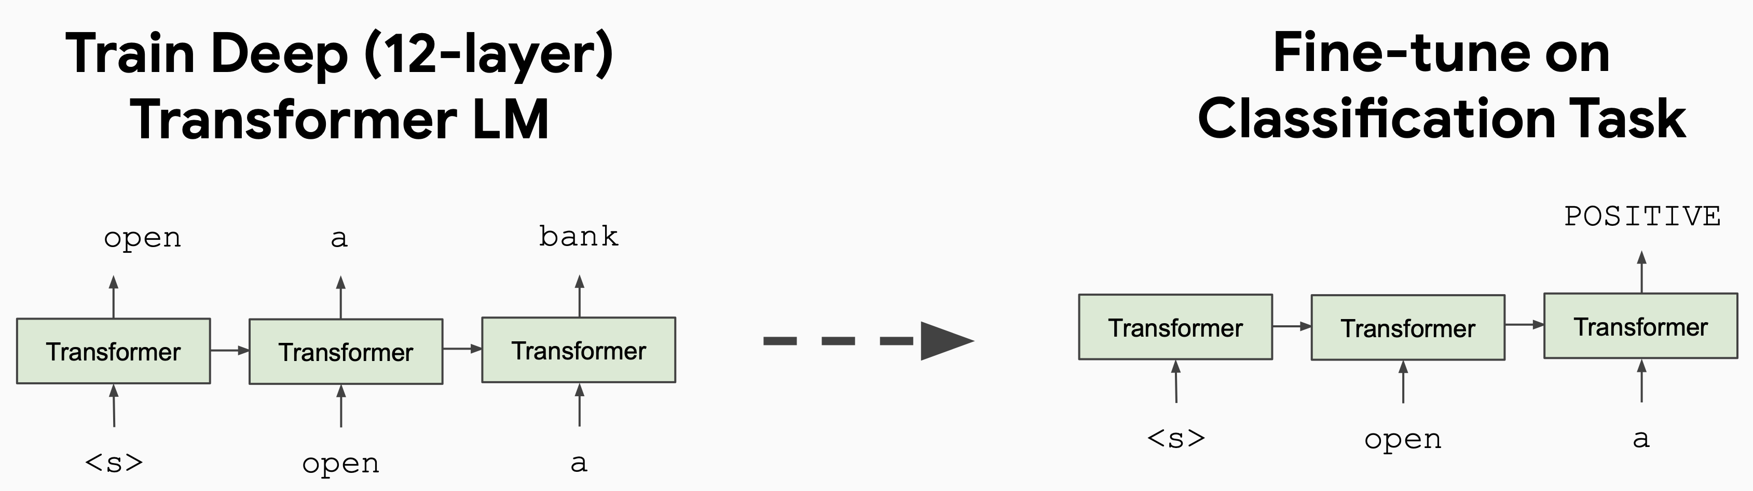
GPT1
Fig from J. Devlin BERT slides
See also ULMFit: https://arxiv.org/abs/1801.06146

Slide 12

GPT models
GPT
Improving language understanding by generative pre-training [Radford et al, 2018]
Large language model with transformers with supervised fine-tuning
    different model for each task
Trained on BooksCorpus (800M words), 117M parameters (12 layers)
GPT-2
Language Models are Unsupervised Multitask Learner [Radford et al, 2019]
Model all tasks as sequence completion with special tokens indicating task
Trained on WebText (40B words), 1.5B parameters (48 layers)
No fine-tuning, demonstrated few-shot learning
GPT-3
Language Models are Few-Shot Learners [Brown et al, 2020]
Trained on Web+Books+Wikipedia (300B words), 175B parameters (96 layers)
Demonstrated zero-shot and few-shot prompting abilities

Slide 13
GPT models (after GPT-3)
Supervised fine-tuning on human conversations
Data where human will pretend to be user or AI assistant
InstructGPT and GPT-3.5 [2022]
Align responses to human feedback
Instruction fine-tuning
Reinforcement learning from human feedback
Used in initial ChatGPT
GPT-4 [March 2023]
Multimodal with images and text (GPT-4V)
Larger, better model (estimated 1.7 trillion parameters)
Turbo [Nov 2023] - longer context (128K)
GPT-4o (omni) [May 2024]
Multimodal with audio, images and text (GPT-4V)
Real-time processing and generation
o1 [September 2024], o3 [mini - January 2025] - Reasoning
Human rank generated output
Use reinforcement learning to improve generation
Notes:
and GPT-4V [September 2023]

Slide 14
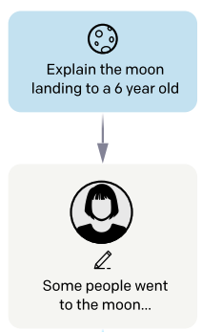
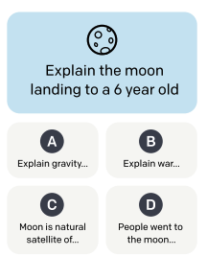
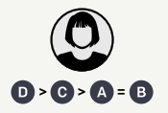


Training stages for modern LLMs
Text with “instructions” and “responses”
List three fruit
Human preference data
Data about what people prefer
Piles of unlabeled text!
Apple, orange,
banana
Self-supervised training
LM objective
Supervised training
LM objective
Reinforcement learning
$$p(w_{t}|w_{<t})$$
$$p(w_{t}|w_{<t};\text{prompt})$$
Preference optimization
Align to human preferences
Pre-training
LM training on large, large amount of data
Instruction-tuning
Supervised fine-tuning for instructions
Pre-training can be broken into stages (mid-training)
Post-training
(Can have more iterations)

Slide 15
LLM performance depends on
Model architecture
Training strategy
Training objective
Training data

Slide 16
Pretraining language models
Model (Neural Architecture)
  Does it use FFN, RNN (LSTM, GRU), or Transformer?
    Is it an encoder-based, decoder-based, or encoder-decoder model?
  Specifics of the neural architecture (number of layers, embedding size, etc)
Dataset
  What is the data that is used to pretrain the model?
Training objective
  What is the training objective?
Other details
  Tokenization: what tokenization is applied?
  Implementation and training details?

Slide 17
Development of Open LLMs
Closed LLMs
GPT (OpenAI)
Claude (Anthropic)
Gemini (Google)
Open weights
LLaMa (Meta)
DeepSeek
Mistral (Mistral AI)
Qwen (Alibaba)
Gemma (Google)
Open weights + data
OLMo (AI2)
DCLM
Amber
BLOOM
Pythia
Open weights + partial data
StableLM
Zamba
Falcon

Slide 18
Pre-training Transformers
Representation Learning

Slide 19
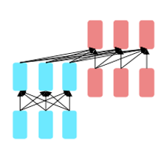
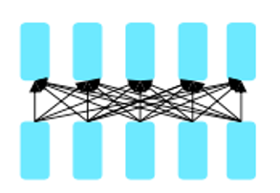
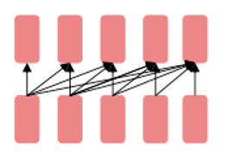

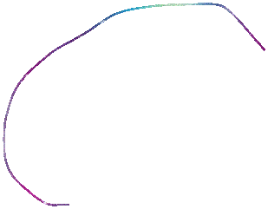
Transformers for pretraining
Recall L12 P64:
Self-supervised Transformer based models shattered language understanding benchmarks in NLP in 2018.
Trained on large text corpus with self-supervised objectives and then transferred.
Encoder only
Decoder only
Encoder-Decoder
Machine translation
Understanding
Generation
Unmasked
Masked
Hybrid
Masked language models
Bidirectional context
BERT + variants (e.g. RoBERTa)
Language models
Can’t condition on future words, good for generation
GPT, LLaMa, PaLM
Combine benefits of both
Original Transformer, UniLM, BART, T5
Slide adapted from: Stanford CS224n, John Hewitt

Slide 20
Transformers for pretraining
Self-supervised Transformer based models shattered language understanding benchmarks in NLP in 2018.
Trained on large text corpus with self-supervised objectives and then transferred.
Encoder only
Decoder only
Encoder-Decoder
Masked language models
Bidirectional context
BERT + variants (e.g. RoBERTa)
Language models
Can’t condition on future words, good for generation
GPT, LLaMa, PaLM
Combine benefits of both
Original Transformer, UniLM, BART, T5
Slide adapted from: Stanford CS224n, John Hewitt

Slide 21
Masked language models:
Word2Vec to BERT
Paper | Model | Dataset | Training Objective
W2V CBOW [Miklov et al, 2013] | FFN | Google News (100B words) | Masked LM (within window)
ELMo [Peters et al, 2018] | Bi-LSTM | 1B Word benchmark (800M words) | Bidirectional LM
BERT [Devlin et al, 2018] | Transformer (encoder block) | BookCorpus + English Wikipedia (3.3B words) | Masked LM Next sentence prediction
Bidirectional Encoder Representations from Transformers

Slide 22

Masked LM
Next sentence prediction

Slide 23
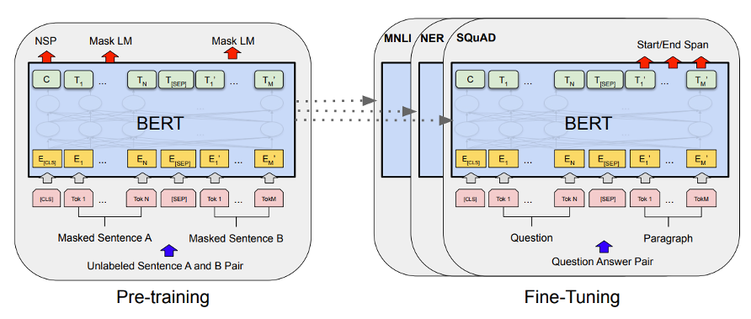
Pre-training and fine-tuning
BERT: Pre-training of Deep Bidirectional Transformers for Language Understanding https://arxiv.org/pdf/1810.04805.pdf
Notes:
The first token of every sequence is always a special classification token ([CLS]).
Same network during pre-training and fine-tuning
For the pre-training corpus we use the BooksCorpus (800M words) (Zhu et al., 2015) and English Wikipedia (2,500M words).
Compared to pre-training, fine-tuning is relatively inexpensive. All of the results in the paper can be replicated in at most 1 hour on a single Cloud TPU, or a few hours on a GPU, starting from the exact same pre-trained model

Slide 24
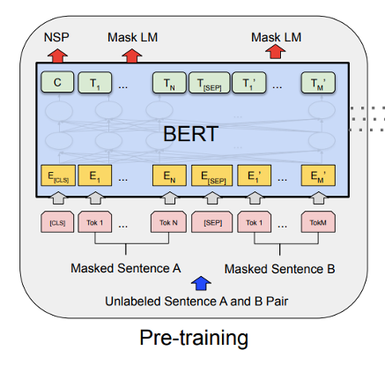
BERT
Transformer Encoder
Two training objectives
  Masked Language Modeling
  Next Sentence Prediction
From the show: Sesame Street

Slide 25
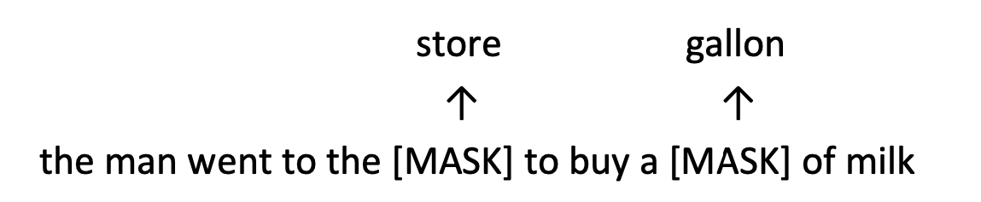
Masked language models (MLMs)
Solution: Mask out 15% of the input words, and then predict the masked words
Too little masking: too expensive to train
Too much masking: not enough context

Slide 26
Masked language models (MLMs)
A little more complex
(don’t always replace with [MASK]):
Example: my dog is hairy, we replace the word hairy
80% of time: replace word with [MASK] token
    my dog is [MASK]
10% of time: replace word with random word
my dog is apple
10% of time: keep word unchanged to bias representation toward actual observed word
my dog is hairy
Teaches the model to use surrounding context to fill in missing information
Detecting errors: Forces the model not to blindly trust input words.
Because [MASK] is never seen when BERT is used for downstream tasks

Slide 27
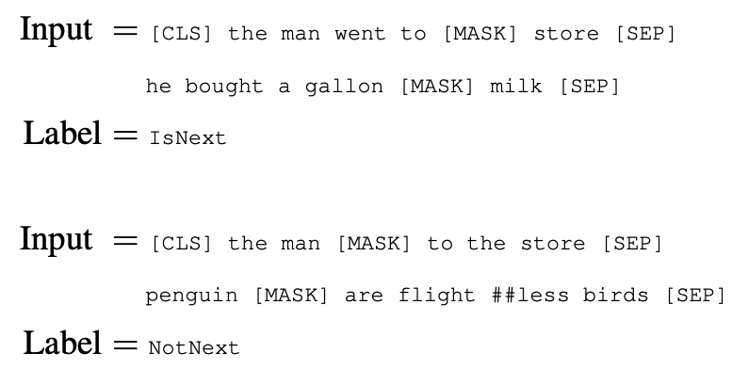
Next sentence prediction (NSP)
Always sample two sentences, predict whether the second sentence is followed after the first one.
Recent papers show that NSP is not necessary…
(Joshi*, Chen* et al, 2019) :SpanBERT: Improving Pre-training by Representing and Predicting Spans
(Liu et al, 2019): RoBERTa: A Robustly Optimized BERT Pretraining Approach

Slide 28
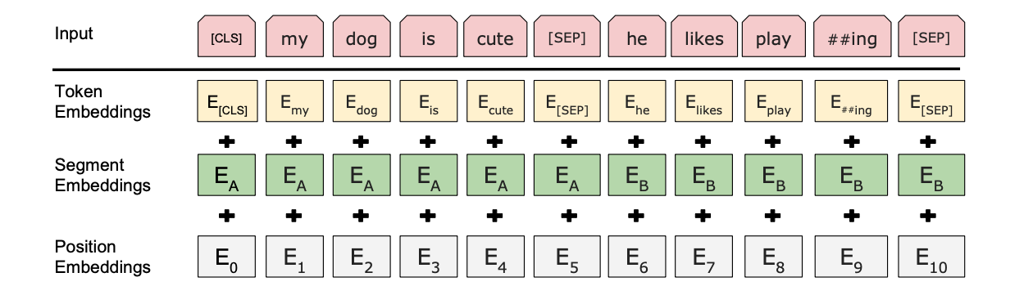
More details
Input representations
Sum of embeddings
Use word pieces instead of words: playing => play ##ing (30K token vocabulary)
Segment length: 512 tokens
Trained 40 epochs on Wikipedia (2.5B tokens) + BookCorpus (0.8B tokens)
Released two model sizes: BERT_base, BERT_large
Notes:
WordPiece embeddings (Wu et al., 2016) with a 30,000 token vocabulary
Total vocabulary of between 8k and 32k wordpieces achieves both good accuracy (BLEU scores) and fast decoding speed
For a given token, its input representation is constructed by summing the corresponding token, segment, and position embeddings

Slide 29
Pre-training and fine-tuning
Key idea: all the weights are fine-tuned on downstream tasks
Notes:
The first token of every sequence is always a special classification token ([CLS]).
Same network during pre-training and fine-tuning
For the pre-training corpus we use the BooksCorpus (800M words) (Zhu et al., 2015) and English Wikipedia (2,500M words).
Compared to pre-training, fine-tuning is relatively inexpensive. All of the results in the paper can be replicated in at most 1 hour on a single Cloud TPU, or a few hours on a GPU, starting from the exact same pre-trained model

Slide 30
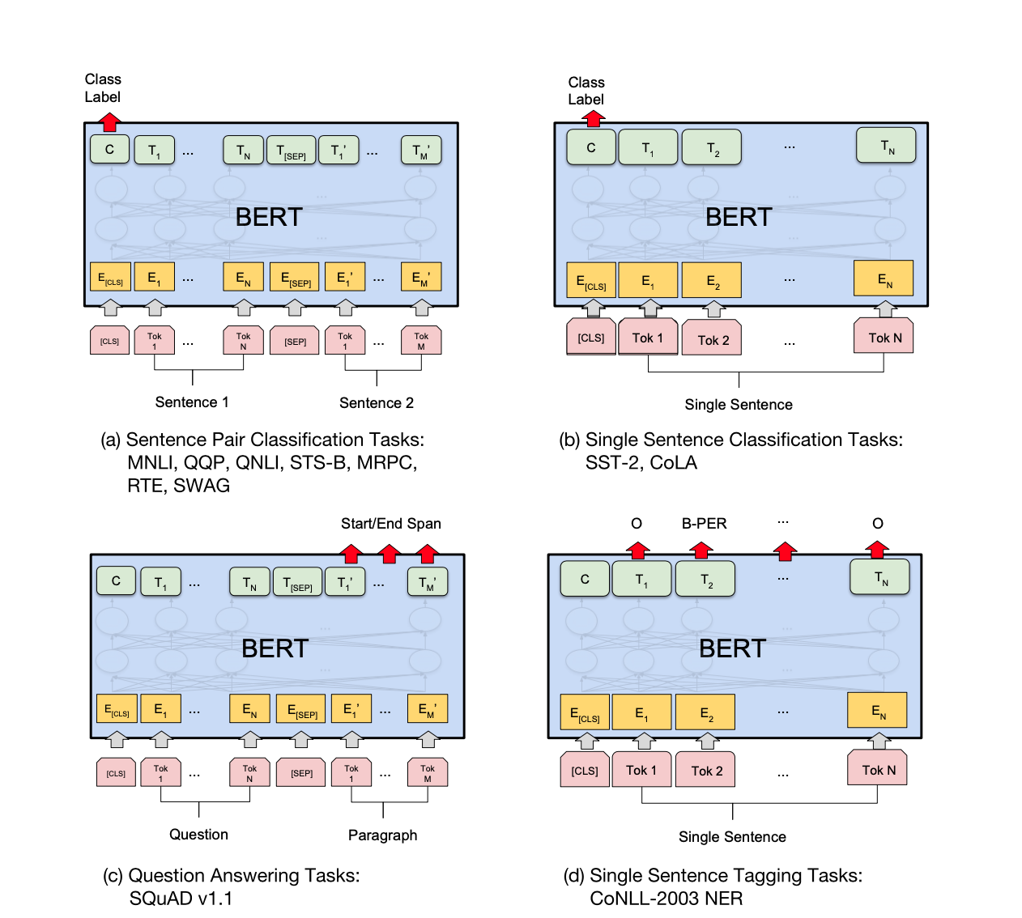
Applications
Notes:
The only new parameters introduced during fine-tuning are classification layer weights W ∈
RK×H, where K is the number of labels. We compute a standard classification loss with C and W,
i.e., log(softmax(CWT))

Slide 31
Applications
Notes:
The first token of every sequence is always a special classification token ([CLS]).

Slide 32
Applications

Slide 33
Applications
completely ignored
Quiz: why the C not in
the last token position?

Slide 34

Applications

Slide 35
BERT Details
Two models were released:
• BERT-base: 12 layers, 768-dim hidden states, 12 attention heads, 110 million params.
• BERT-large: 24 layers, 1024-dim hidden states, 16 attention heads, 340 million params.
Trained on:
• BooksCorpus (800 million words)
• English Wikipedia (2,500 million words)
Pretraining is expensive and impractical on a single GPU.
• BERT was pretrained with 64 TPU (Tensor Processing Unit) chips for a total of 4 days.
• (TPUs are special tensor operation acceleration hardware)
Finetuning is practical and common on a single GPU
• “Pretrain once, finetune many times.”

Slide 36
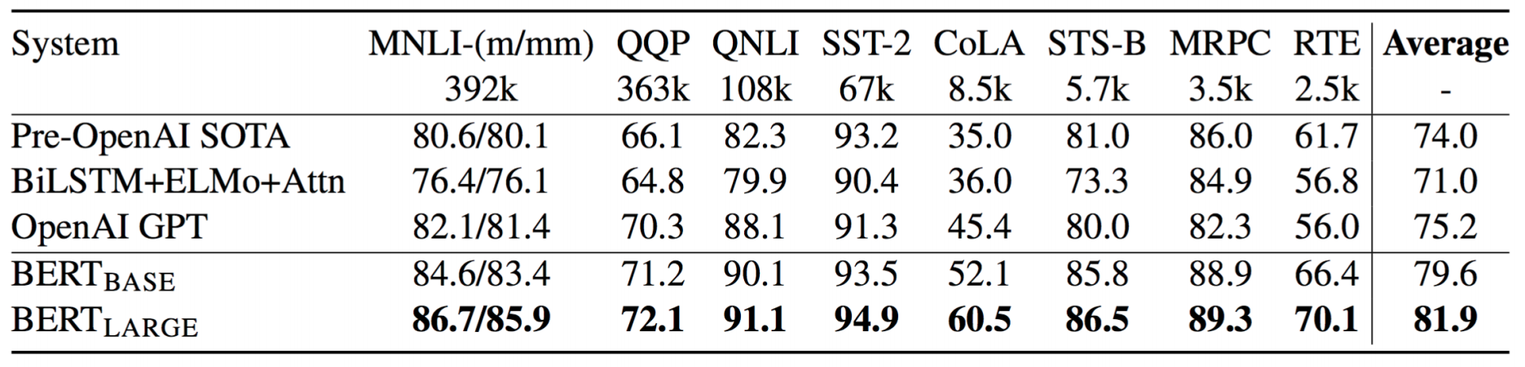
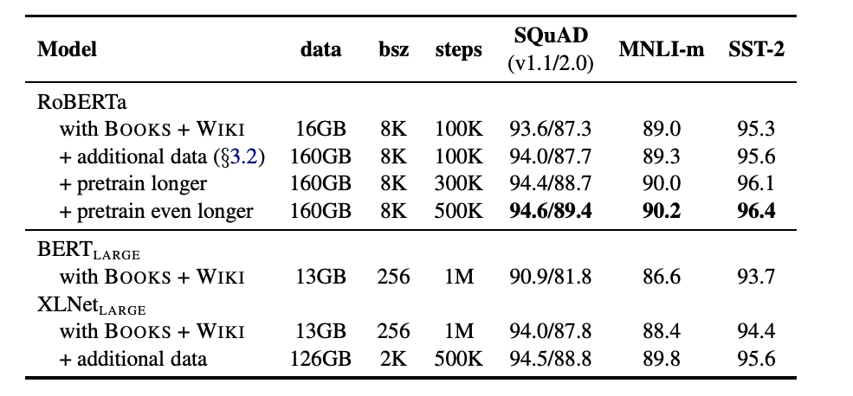
Experimental results
Infer. reasoning
BiLSTM: 63.9
Entailment
MNLI: multilingual NLI
QNLI: NLI with SQuAD data
RTE: Textual Entailment
Similarity
QQP: Quora Question Pairs
STS-B: Semantic Textual Similarity
MRPC: MS Research Paraphrase Corpus
Other
SST-2: sentiment analysis
CoLA: Linguistic acceptability
SQuAD: question answering
(Wang et al, 2018): GLUE: A Multi-Task Benchmark and Analysis Platform for Natural Language Understanding
Notes:
We use a batch size of 32 and fine-tune for 3 epochs over the data for all GLUE tasks.

Slide 37
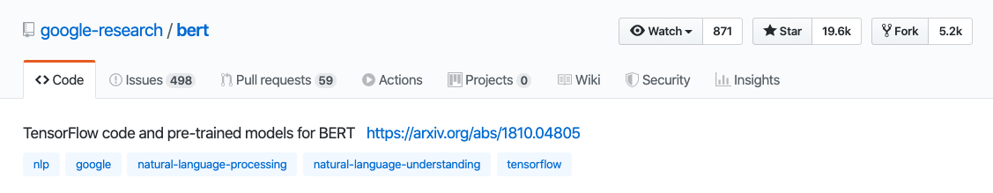
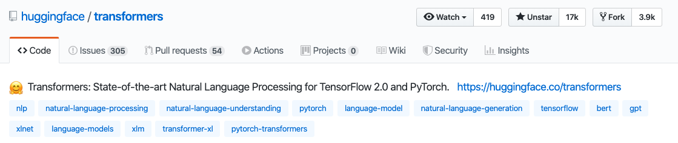
Use BERT in practice
TensorFlow: https://github.com/google-research/bert
PyTorch: https://github.com/huggingface/transformers
Notes:
https://allennlp.org/elmo

Slide 38

Contextualized word embeddings in context
TagLM (Peters et, 2017)
CoVe (McCann et al. 2017)
ULMfit (Howard and Ruder, 2018)
ELMo (Peters et al, 2018)
OpenAI GPT (Radford et al, 2018)
BERT (Devlin et al, 2018)
OpenAI GPT-2 (Radford et al, 2019)
XLNet (Yang et al, 2019)
SpanBERT (Joshi et al, 2019)
RoBERTa (Liu et al, 2019)
ALBERT (Lan et al, 2019)
DistilBERT (Sanh et al, 2019)
ELECTRA (Clark et al, 2020)
…
https://github.com/huggingface/transformers
See https://huggingface.co/transformers/
for more information and models
Notes:
ELMo - learn weighted average of all layers, TagLM - top most layer

Slide 39
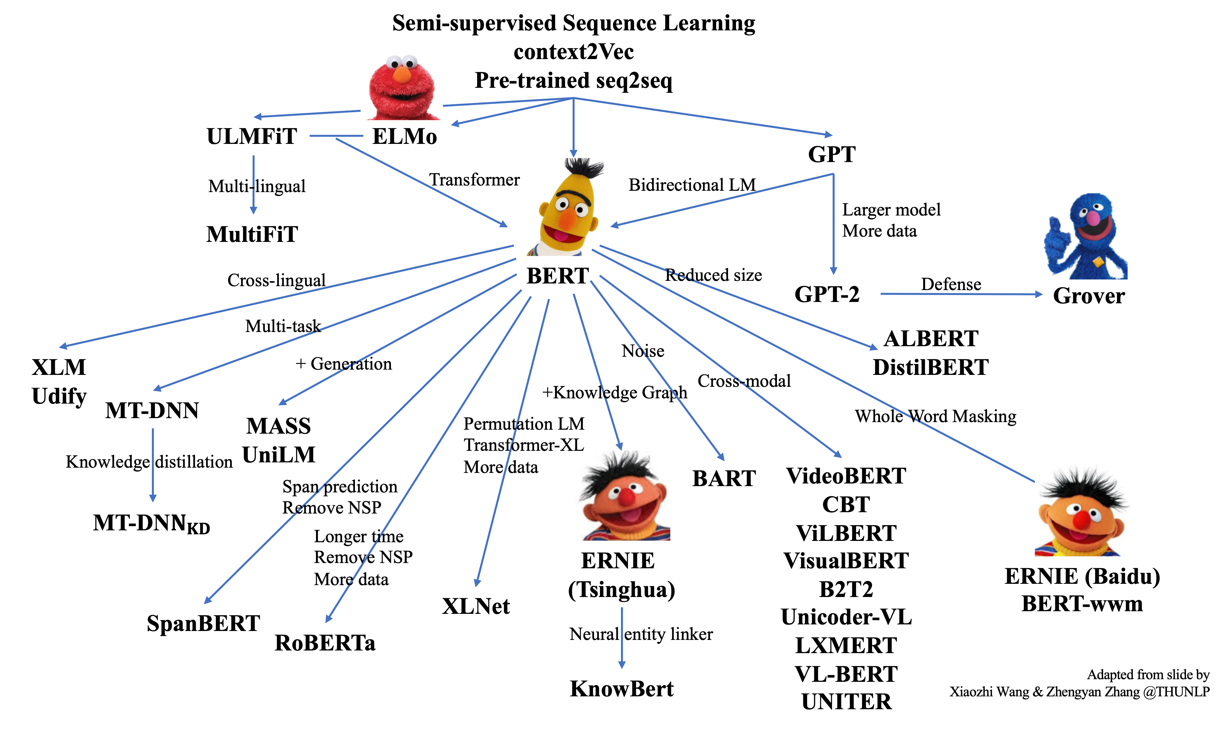
Notes:
ELMo and BERT and friends are everywhere!

Slide 40
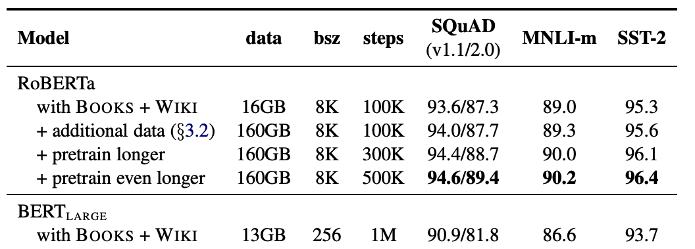
RoBERTa
  Train with more data and for more epochs
    Vocabulary size of 50K subword units vs 30K for BERT
    Larger batch size and more training data
  No need for NSP
pretrain with 1024 V100 GPUs for ~1 day
RoBERTa: A Robustly Optimized BERT Pretraining Approach
Liu et al, UW and Facebook, arXiv 2019
Notes:
50K subword units vs 30K for BERT
Dynamic masking (masking changes)

Slide 41
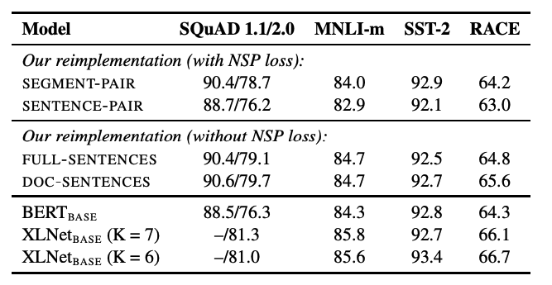
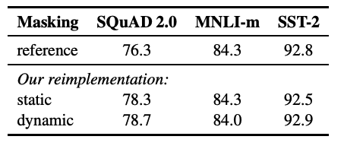
RoBERTa
  Train with more data and for more epochs
    Vocabulary size of 50K subword units vs 30K for BERT
    Larger batch size and more training data
  No need for NSP
Dynamic masking (masking changes)
Better results with careful reimplementation.
Mean over 5 random seeds.
RoBERTa: A Robustly Optimized BERT Pretraining Approach
Liu et al, UW and Facebook, arXiv 2019
Notes:
BERT-base
SEGMENT - up to 512 tokens,
SENTENCE - natural sentence
FULL-SENTENCES - 512 tokens (can cross document boundaries)
DOC-SENTENCES - 512 tokens, does not cross document boundaries

Slide 42
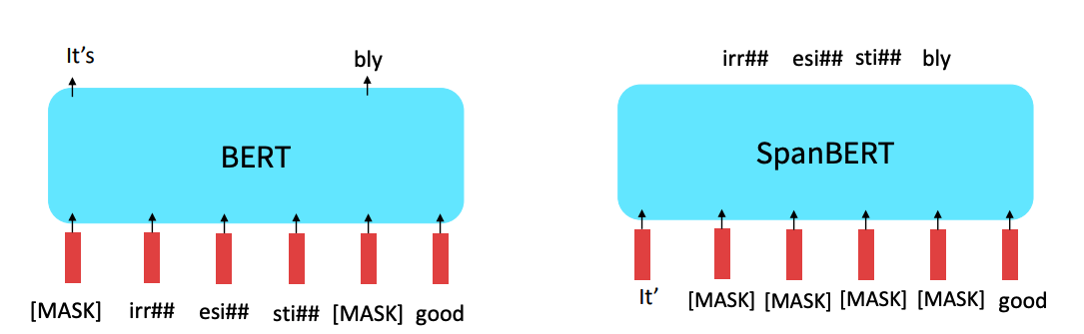
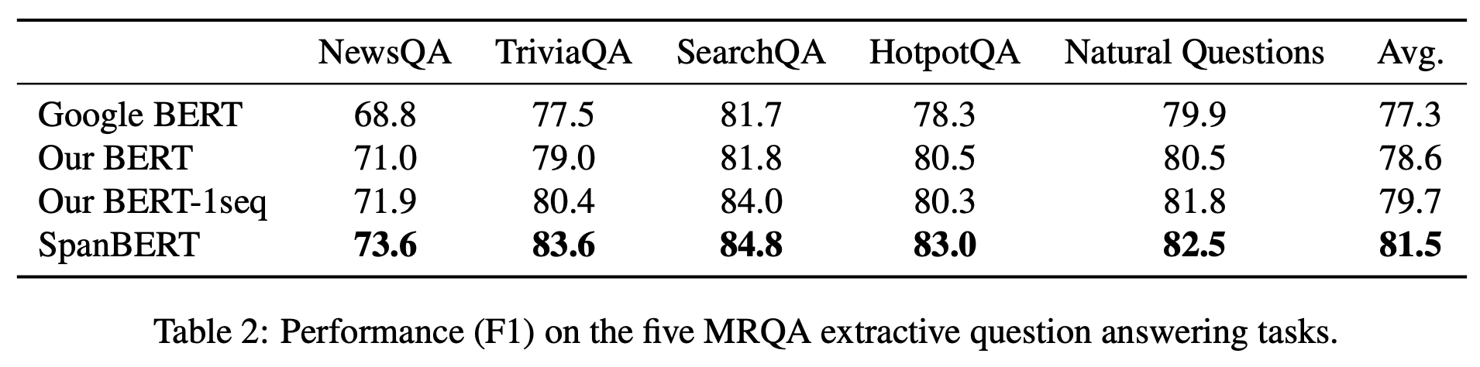
SpanBERT
Mask out spans!
SpanBERT: Improving Pre-training by Representing and Predicting Spans
Joshi et al, TACL 2019

Slide 43
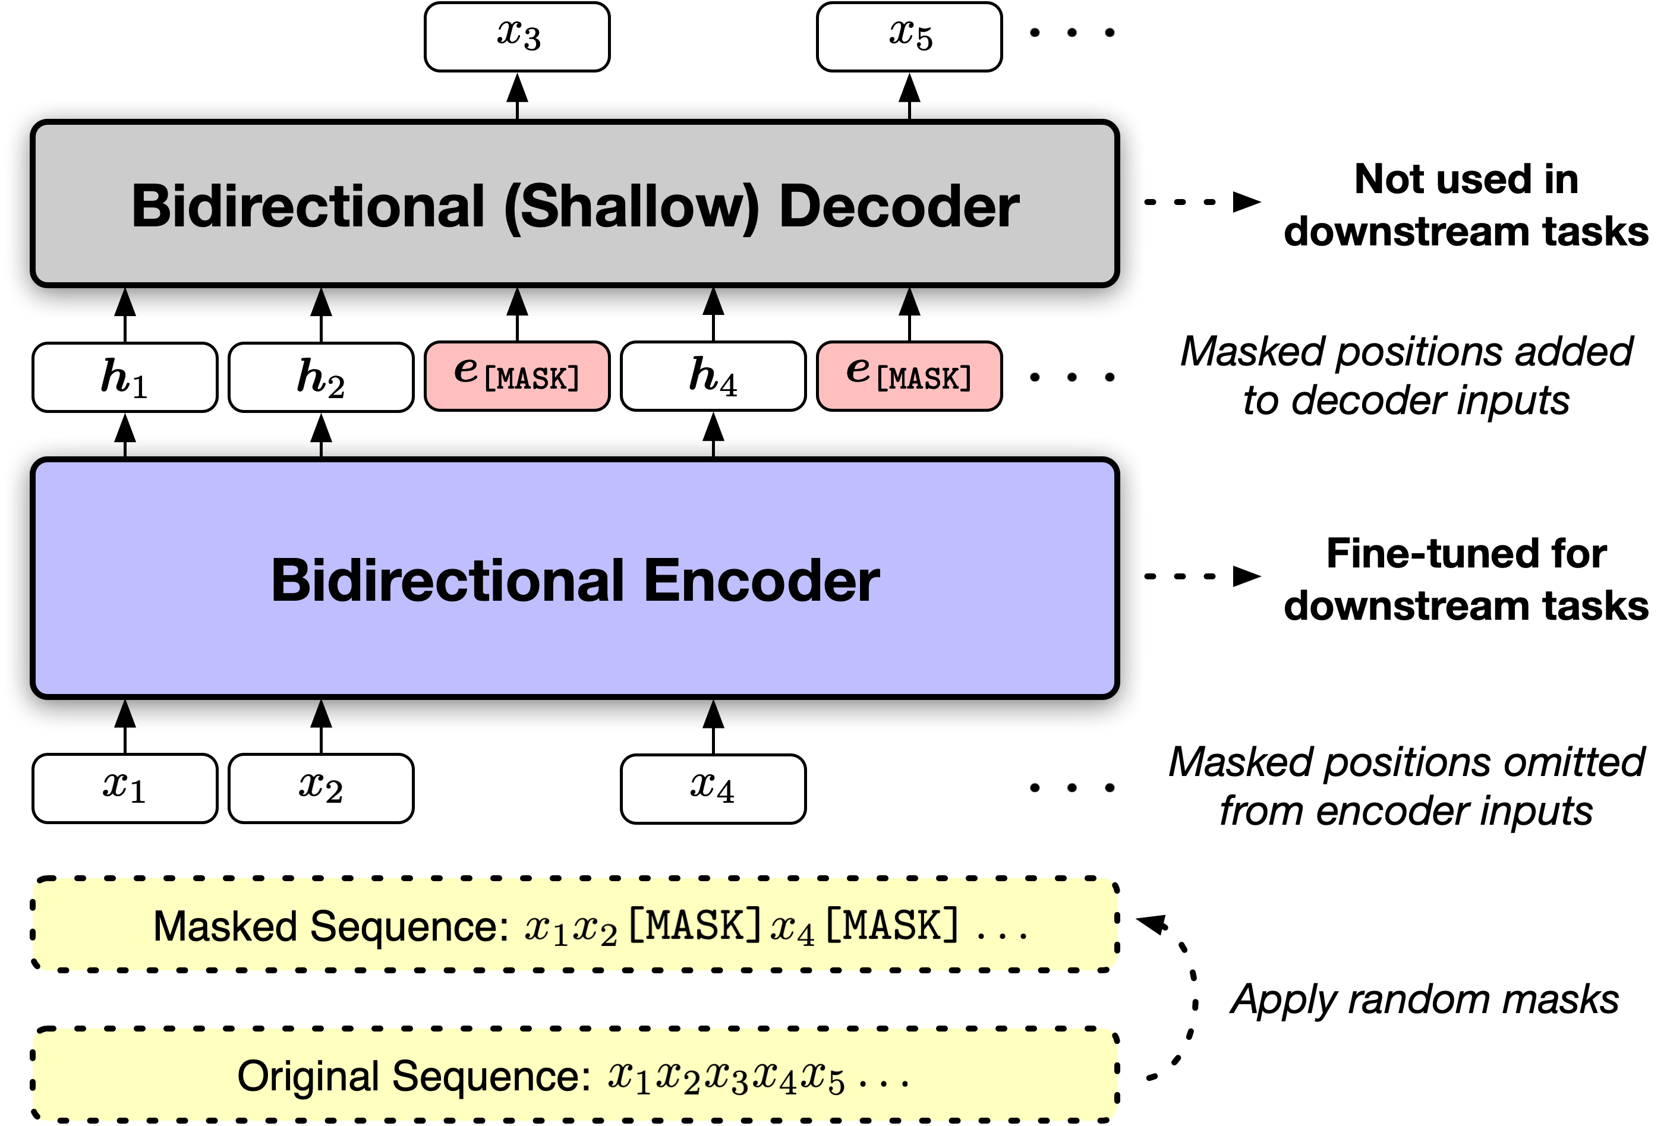
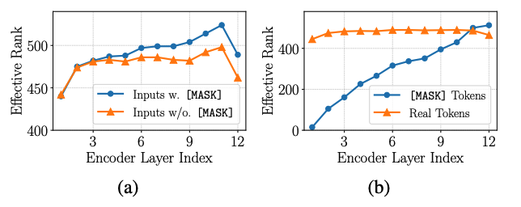

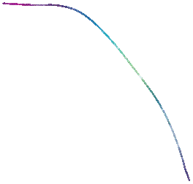
MAE-LM (Masked Autoencoder LM)
dummy learnable vectors
[MASK] tokens are not observed in downstream tasks
Model capacity wasted for [MASK] tokens
Only feed non-masked tokens into encoder, have separate decoder (discarded) that predicts masked tokens
Representation Deficiency in Masked Language Modeling [Meng et al. 2024]

Slide 44
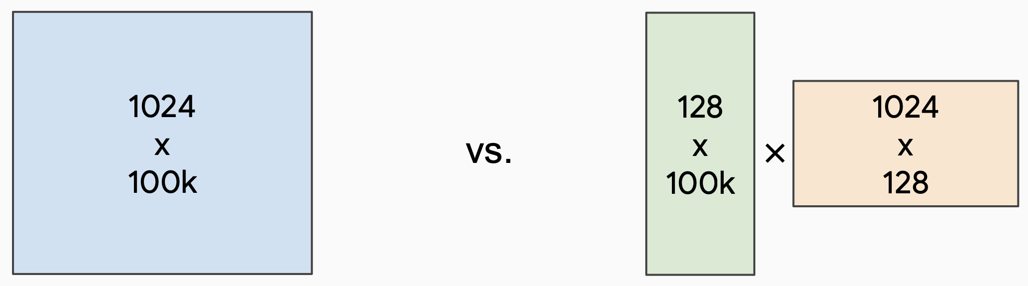






ALBERT
https://arxiv.org/abs/1909.11942
Lan+ 2019
Factorized embedding parameterization
  Use small embedding size (128) and project to Transformer hidden size (1024) using a parameter matrix
Word embedding matrix
Word embedding matrix
Projection matrix

Slide 45
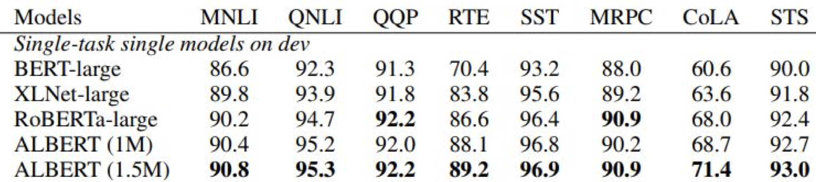
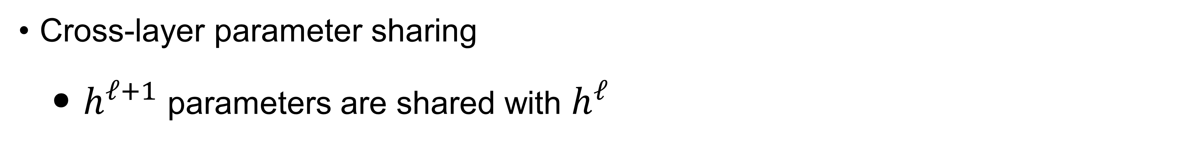
ALBERT
https://arxiv.org/abs/1909.11942
Cross-layer parameter sharing
  $h^{ℓ+1}$ parameters are shared with $h^{ℓ}$
Q: This reminds you of which model?
Notes:
Behaves Like an Unrolled Recurrent Network (RNN)

Slide 46
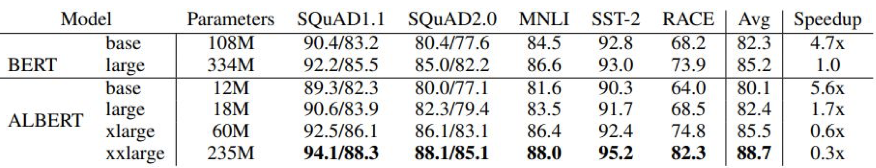
ALBERT
https://arxiv.org/abs/1909.11942
Light on parameters; not necessarily faster than BERT

Slide 47
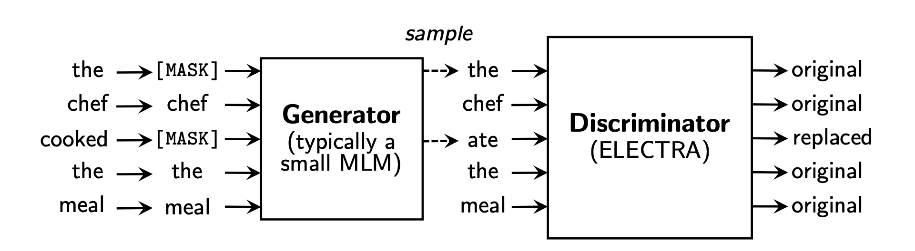
Discriminative training
Loss is on all the training tokens vs just the masked ones, more compute efficient use of the training data
Train model to discriminate locally plausible text from real text
ELECTRA: Pre-training Text Encoders as Discriminators Rather Than Generators
Clark et al, ICLR 2020

Slide 48
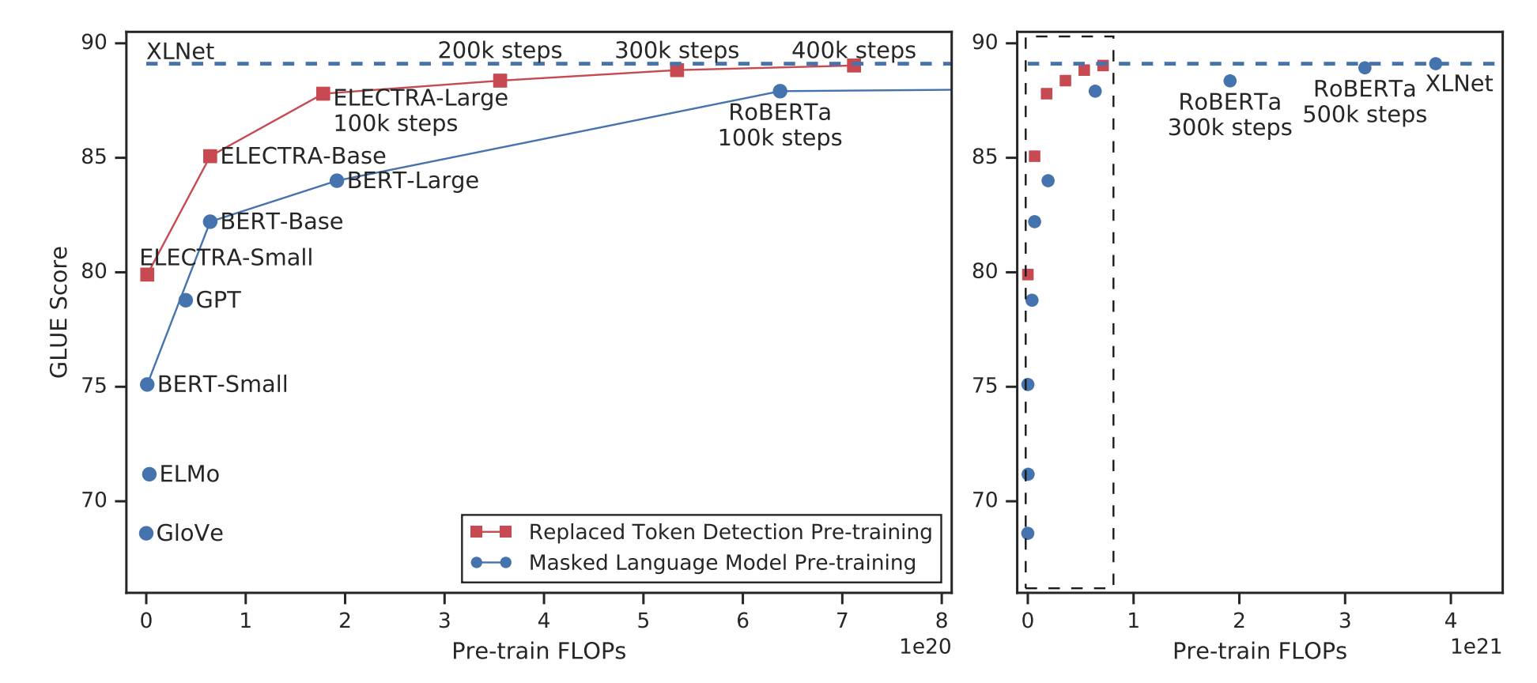
Discriminative training
ELECTRA: Pre-training Text Encoders as Discriminators Rather Than Generators
Clark et al, ICLR 2020

Slide 49
Transformers for pretraining
Self-supervised Transformer based models shattered language understanding benchmarks in NLP in 2018.
Trained on large text corpus with self-supervised objectives and then transferred.
Encoder only
Decoder only
Encoder-Decoder
Generation
Masked
Masked language models
Bidirectional context
BERT + variants (e.g. RoBERTa)
Language models
Can’t condition on future words, good for generation
GPT, LLaMa, PaLM
Combine benefits of both
Original Transformer, UniLM, BART, T5

Slide 50
GPT models
GPT
Improving language understanding by generative pre-training [Radford et al, 2018]
Large language model with transformers with supervised fine-tuning
    different model for each task
Trained on BooksCorpus (800M words), 117M parameters (12 layers)
GPT-2
Language Models are Unsupervised Multitask Learner [Radford et al, 2019]
Model all tasks as sequence completion with special tokens indicating task
Trained on WebText (40B words), 1.5B parameters (48 layers)
No fine-tuning, demonstrated few-shot learning
GPT-3
Language Models are Few-Shot Learners [Brown et al, 2020]
Trained on Web+Books+Wikipedia (300B words), 175B parameters (96 layers)
Demonstrated zero-shot and few-shot prompting abilities

Slide 51
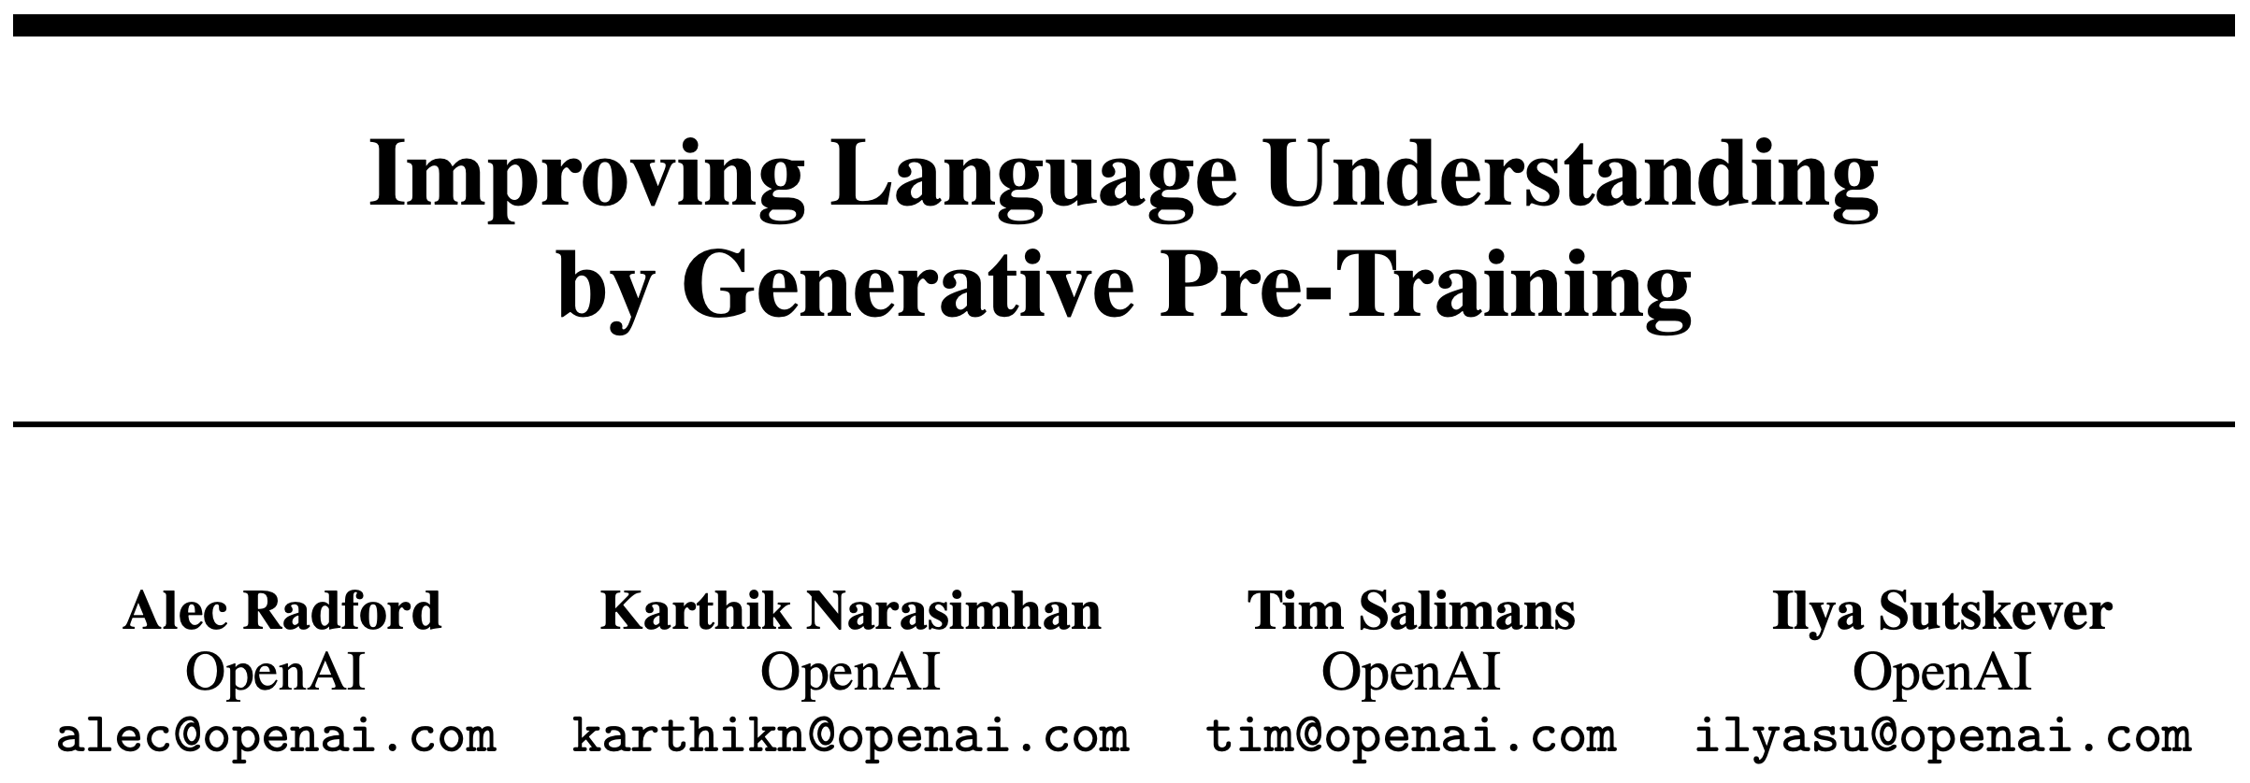
GPT1
https://openai.com/research/language-unsupervised
Jun 2018

Slide 52
GPT1
Fig from J. Devlin BERT slides
See also ULMFit: https://arxiv.org/abs/1801.06146

Slide 53
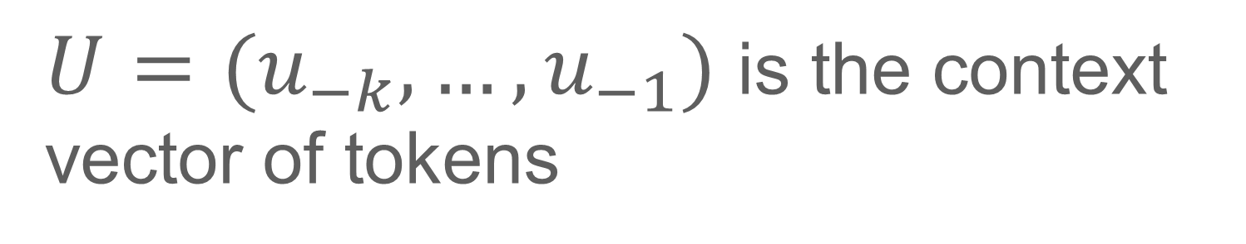
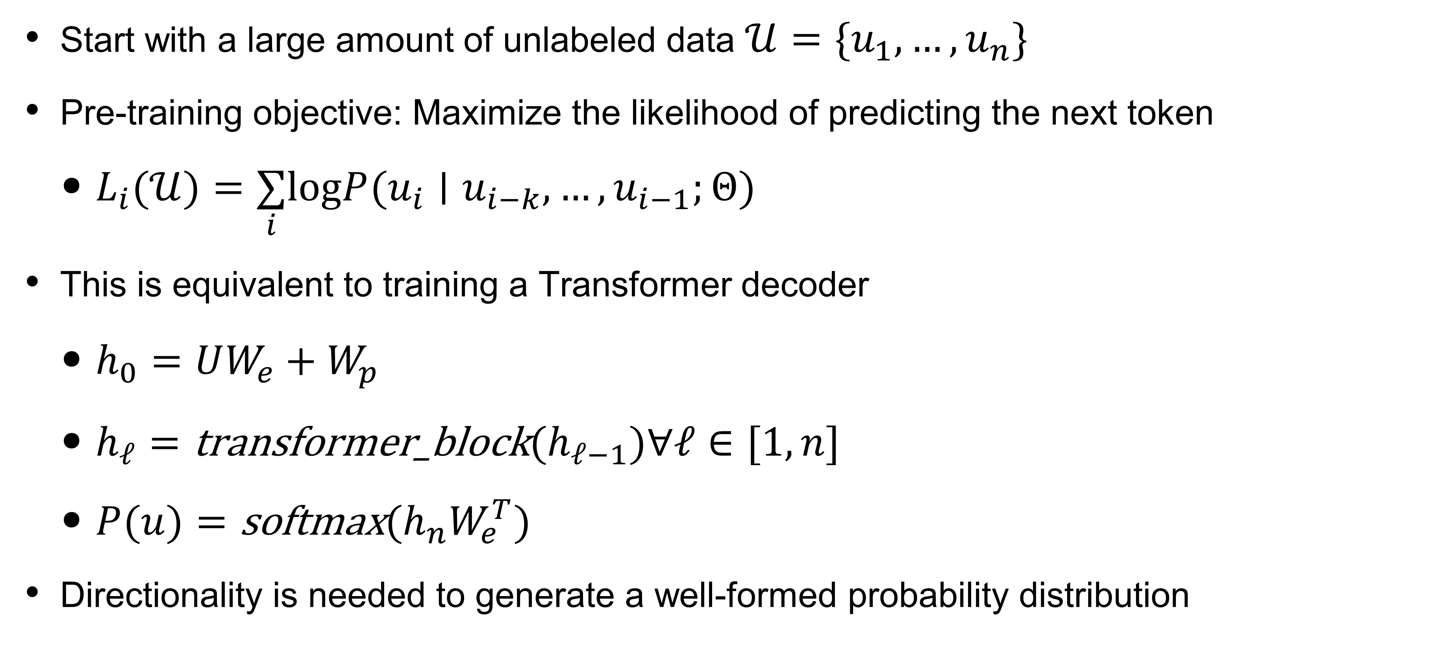
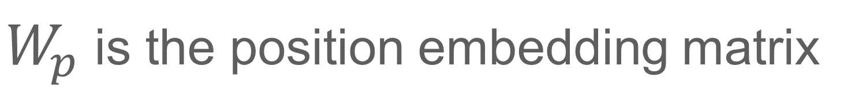
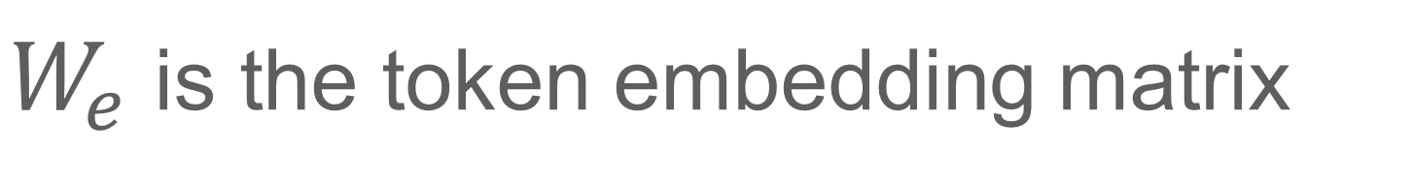
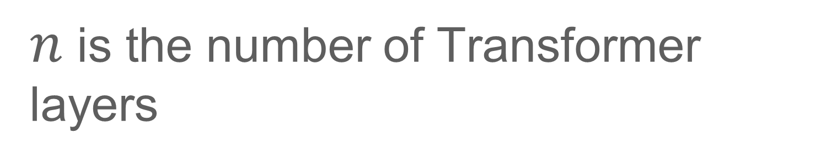
GPT1
Pre-training an autoregressive language model
BooksCorpus: 7K unpublished books (1B words)
Start with a large amount of unlabeled data $𝒰=\{u_{1},…,u_{n}\}$
Pre-training objective: Maximize the likelihood of predicting the next token
  $L_{i}(𝒰)=\underset{i}{∑}logP(u_{i}∣u_{i−k},…,u_{i−1};Θ)$
This is equivalent to training a Transformer decoder
  $h_{0}=UW_{e}+W_{p}$
  $h_{ℓ}=\text{transformer}\text{_}\text{block}(h_{ℓ−1})∀ℓ∈[1,n]$
  $P(u)=\text{softmax}(h_{n}W_{e}^{T})$
Directionality is needed to generate a well-formed probability distribution
$U=(u_{−k},…,u_{−1})$ is the context vector of tokens
$n$ is the number of Transformer layers
$W_{e}$ is the token embedding matrix
$W_{p}$ is the position embedding matrix

Slide 54
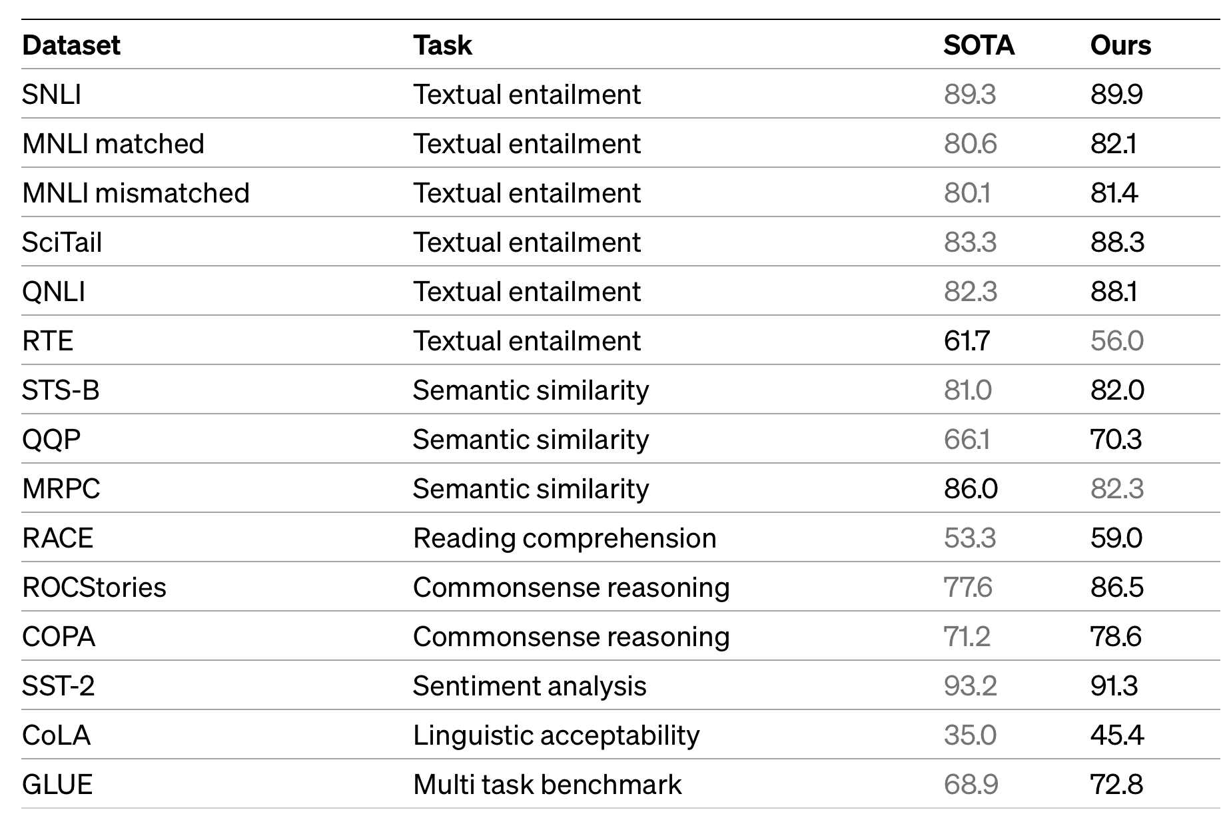
GPT1
https://openai.com/research/language-unsupervised

Slide 55
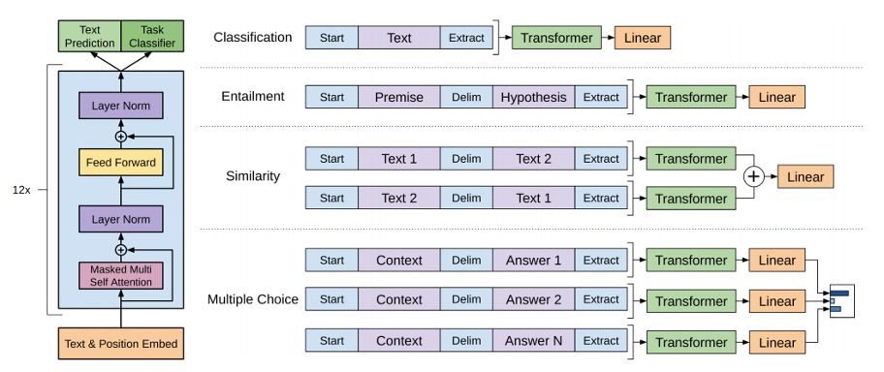
GPT (Generative pretrained transformer)
Unsupervised pre-training: Standard language model loss
Supervised fine-tuning: Use simple classifier (linear layer + softmax) trained to predict correct class (use combined loss)
Improving language understanding by generative pre-training (Radford et al, 2018)

Slide 56


GPT-2
Express all tasks as a language modelling task
Training improvements
  Improved initialization / additional layer normalization
  Increased vocabulary / context /batch size
Machine Translation
(figure credit: Jay Alammar
http://jalammar.github.io/illustrated-gpt2/)
Language Models are Unsupervised Multitask Learner (Radford et al. 2019)

Slide 57

GPT-2
How can we use decoders for different tasks?
  Use special token to indicate task
Machine Translation
Summarization
(figure credit: Jay Alammar
http://jalammar.github.io/illustrated-gpt2/)
Language Models are Unsupervised Multitask Learner (Radford et al. 2019)
Notes:
Training improvements
Improved initialization / additional layer normalization
Increased vocabulary / context /batch size

Slide 58

GPT-2
How can we use decoders for different tasks?
Use special token to indicate task
Summarization
(figure credit: Jay Alammar
http://jalammar.github.io/illustrated-gpt2/)
Language Models are Unsupervised Multitask Learner (Radford et al. 2019)

Slide 59


GPT-3: Few-shot learning
      0 training
      examples
      1 training
      examples
A few examples are provided at test time
No task description, only the input: cheese
Language Models are Few-Shot Learners (Brown et al. OpenAI, 2020)
Notes:
Similar to GPT-2, modified initialization, pre-normalization,
and reversible tokenization
But has alternating dense and locally banded sparse
attention patterns

Slide 60

GPT-4
Growing performance for ChatGPT versions
https://openai.com/research/gpt-4

Slide 61

Autoregressive decoder-only models
GPT
Rise of LLMs
Multi-task training: modelling all tasks as autoregressive language modeling
Scaling up to hundreds of billions of parameters
Scaling up requires system engineering, tweaks to architecture for training stability
Multi-lingual, multi-modal…
https://jalammar.github.io/illustrated-gpt2/
Objectives: next token prediction

Slide 62
Larger and larger language models
GPTv4 (1.7T?, OpenAI)
Megatron-Turing NLG (530B,
MS+NVidia)
PaLM (540B, Google)
Bloom (176B, HuggingFace+BigScience)
LaMDA (137B, Google)
Chinchilla (70B, DeepMind)
Llama (65B, FAIR)
2023
2024
https://huggingface.co/blog/large-language-models
Notes:
Up to trillions of parameters

Slide 63

New capabilities emerge at scale
https://ai.googleblog.com/2022/04/pathways-language-model-palm-scaling-to.html
Notes:
https://arxiv.org/pdf/2012.13255.pdf

Slide 64



Autoregressive decoder-only models
Input: "robot must obey"
pick "orders"
New Input: "robot must obey orders"
pick "given"
GPT
Advances
https://jalammar.github.io/illustrated-gpt2/
Objectives: next token prediction
Objectives: multi token prediction

Slide 65
Transformers for pretraining
Self-supervised Transformer based models shattered language understanding benchmarks in NLP in 2018.
Trained on large text corpus with self-supervised objectives and then transferred.
Encoder only
Decoder only
Encoder-Decoder
Machine translation
Hybrid
Masked language models
Bidirectional context
BERT + variants (e.g. RoBERTa)
Language models
Can’t condition on future words, good for generation
GPT, LLaMa, PaLM
Combine benefits of both
Original Transformer, UniLM, BART, T5

Slide 66






Encoder-Decoder pretraining
Random tokens are replaced with [MAaSK], and the model predicts them using full left-and-right context.
Combine advantages of both encoder and decoder
Seq2Seq LM with masking
Next sentence prediction
The model predicts each word conditioned only on the words to its left.
a learnable vector added to every input token to tell the model which sentence, text span, or segment that token belongs to.
tokens in $S_2$ can attend to all of $S_1$, but only to preceding tokens within $S_2$.
Unified Language Model Pre-training for Natural Language Understanding and Generation [Dong et al, NeurIPS 2019]

Slide 67

UniLM v1
Combine benefits of BERT (encoder) and GPT (decoder)
Unified Language Model Pre-training for Natural Language Understanding and Generation
Dong et al, Microsoft, NeurIPS 2019
Notes:
Unified Language Model Pre-training for Natural Language Understanding and Generation
https://github.com/microsoft/unilm

Slide 68




BART: Denoising seq2seq training
BERT
GPT
BART
Combine benefits of BERT (encoder) and GPT (decoder)
More flexibility in noise generation
BART: Denoising Sequence-to-Sequence Pre-training for Natural Language Generation, Translation, and Comprehension
Lewis et al, Facebook AI, ACL 2020

Slide 69


BART: Denoising seq2seq training
Classification
Machine Translation
BART: Denoising Sequence-to-Sequence Pre-training for Natural Language Generation, Translation, and Comprehension
Lewis et al, Facebook AI, ACL 2020
Notes:
BART: Denoising Sequence-to-Sequence Pre-training for Natural Language Generation, Translation, and Comprehension

Slide 70

T5: Text to Text Transfer Transformer
https://arxiv.org/abs/1910.10683
Treat all NLP problems as encoding text and generating text
Trained on cleaned up version of Common Crawl
Exploring the Limits of Transfer Learning with a Unified Text-to-Text Transformer [Raffel et al, Google, JMLR 2020]
Notes:
BART: Denoising Sequence-to-Sequence Pre-training for Natural Language Generation, Translation, and Comprehension

Slide 71

Exploring the Limits of Transfer Learning with a Unified Text-to-Text Transformer [Raffel et al, Google, JMLR 2020]

Slide 72

T5: Text to Text Transfer Transformer
Normally: Separate parameters for encoder/decoder
Masking similar to encoder/decoder
Causal masking only
Can force sharing of parameters for encoder/decoder
Similar performance, less parameters
Exploring the Limits of Transfer Learning with a Unified Text-to-Text Transformer [Raffel et al, Google, JMLR 2020]
Notes:
BART: Denoising Sequence-to-Sequence Pre-training for Natural Language Generation, Translation, and Comprehension

Slide 73

T5: Text to Text Transfer Transformer
Exploring the Limits of Transfer Learning with a Unified Text-to-Text Transformer [Raffel et al, Google, JMLR 2020]
Notes:
BART: Denoising Sequence-to-Sequence Pre-training for Natural Language Generation, Translation, and Comprehension

Slide 74

T5 (use both encoder and decoder)
Span corruption works best
Slide Credit: Stanford CS224n, John Hewitt

Slide 75


T5: Text to Text Transfer Transformer
Different corruption type
Predict all
Predict corrupted
Different corruption rate
Exploring the Limits of Transfer Learning with a Unified Text-to-Text Transformer [Raffel et al, Google, JMLR 2020]
Notes:
BART: Denoising Sequence-to-Sequence Pre-training for Natural Language Generation, Translation, and Comprehension

Slide 76

T5 (use both encoder and decoder)
Slide Credit: Stanford CS224n, John Hewitt

Slide 77
T5 summary
https://arxiv.org/abs/1910.10683
Raffel+ 2019
Ablation study on many aspects of pre-training and fine-tuning
  Model size (bigger is better; 11B parameters)
  Amount of training data (more is better)
  Domain / cleanliness of training data [-ve]
  Pre-training objective (e.g. span length of masked text) [-ve]
  Ensemble models [-ve]
  Fine-tuning recipe (e.g. only allow top k layers to fine-tune) [-ve]
  Multi-task training [-ve]

Slide 78
Pre-training objectives

Slide 79

Pre-training objectives
Pre-training objectives can be decoupled from architectures
Can train using corruption using Decoder only or Encoder-Decoder objective
UL2: Unifying Language Learning Paradigms [Tay et al. 2023]

Slide 80


Unified pre-training
Mixture-of-denoisers
Train to perform next token prediction with different noise schemes
SpanCorrupt$(μ,r,n)$:
- $μ$ mean span length,
- $r$ corruption rate,
- $n$ number of corrupted spans
Architecture agnostic
UL2: Unifying Language Learning Paradigms [Tay et al. 2023]

Slide 81

Unified pre-training
Mixture-of-denoisers
SpanCorrupt function with three values $(μ,r,n)$: $μ$ mean span length, $r$ corruption rate, $n$ number of curated spans
UL2: Unifying Language Learning Paradigms [Tay et al. 2023]

Slide 82

Unified pre-training
Mode switching with paradigm token: [R], [S], [X] to tell the model which model it is in
Denoisers
Regular Denoising
Short spans (2-5 tokens), Low corruption (15% masking)
Sequential Denoising
prefix LM
Extreme Denoising
Large part (50%) is masked out
Grayed out areas are masked out
Next token prediction
UL2: Unifying Language Learning Paradigms [Tay et al. 2023]

Slide 83
Summary of pretrained models we looked at
Paper | Model | Dataset | Training Objective
W2V CBOW [Miklov et al, 2013] | FFN | Google News (100B words) | Masked LM (within window)
ELMo [Peters et al, 2018] | Bi-LSTM | 1B Word benchmark (800M words) | Bidirectional LM
BERT [Devlin et al, 2018] | Transformer (encoder block) | BookCorpus + English Wikipedia (3.3B words, 16 GB) | Masked LM Next sentence prediction
RoBERTa [Liu et al, 2019] | Transformer (encoder block) | BookCorpus + English Wikipedia + CommonCrawl News + OpenWebText + Stories (160 GB) | Masked LM
GPT2 [Radford et al, 2019] | Transformer (decoder block) | WebText (40 GB) | Traditional LM
BART [Lewis et al, 2019] | Transformer (encoder-decoder) | Same as RoBERTa | Text Denoising (reconstruction)

Slide 84

Getting good embeddings out of decoder only LLMs
https://arxiv.org/pdf/2404.05961

Slide 85

Getting good embeddings out of decoder only LLMs
https://arxiv.org/pdf/2404.05961

Slide 86

T5 (use both encoder and decoder)

